Slide 1
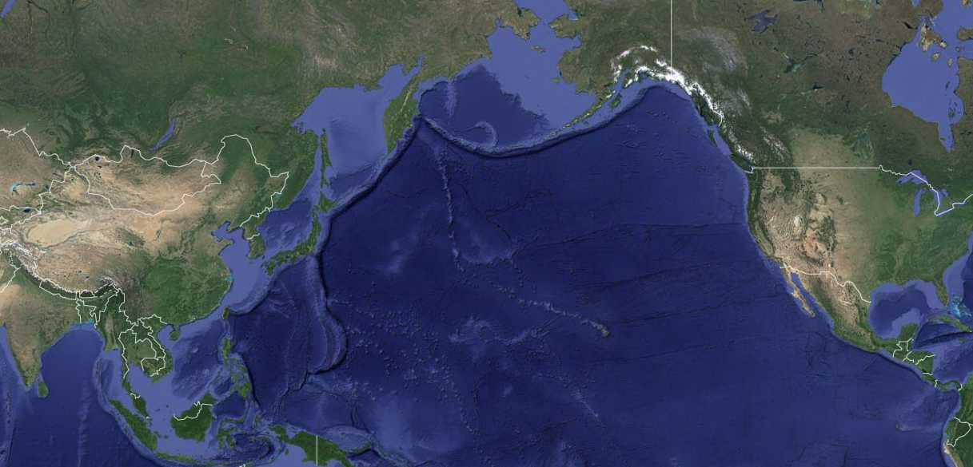
Distributing Lifemapper across the PRAGMA Infrastructure
Nadya Williams, UCSD, nadya@sdsc.edu
Aimee Stewart, KU, astewart@ku.edu
Andréa Matsunaga, UFL, ammatsun@ufl.edu

Slide 2

The goals
Increase scalability, availability and flexibility of Lifemapper software.
Run Lifemapper on PRAGMA testbed with enabled access to private satellite data.
Increase usability of PRAGMA infrastructure as a framework for deployment of scientific applications and data resources.
Notes:
Quick background
VBE – Analyze species distributions using Lifemapper software infrastructure on Mt. Kinabalu, Malaysia to examine this area of high biodiversity
Deployed across multiple PRAGMA sites
On a laptop without internet access (in the field)
With data restricted to a single location
Previous pragma accomplishments in the VBE
Using Rocks cluster software, Package and deploy part 1 - LmCompute at SDSC, compute work for the original Kansas LmServer
Package and deploy both parts 1 and 2: LmCompute and LmServer, have them work together
at SDSC
on a laptop,
In this experiment we are using geographically distributed software and geographically restricted data. Move the computations to the data.

Slide 3
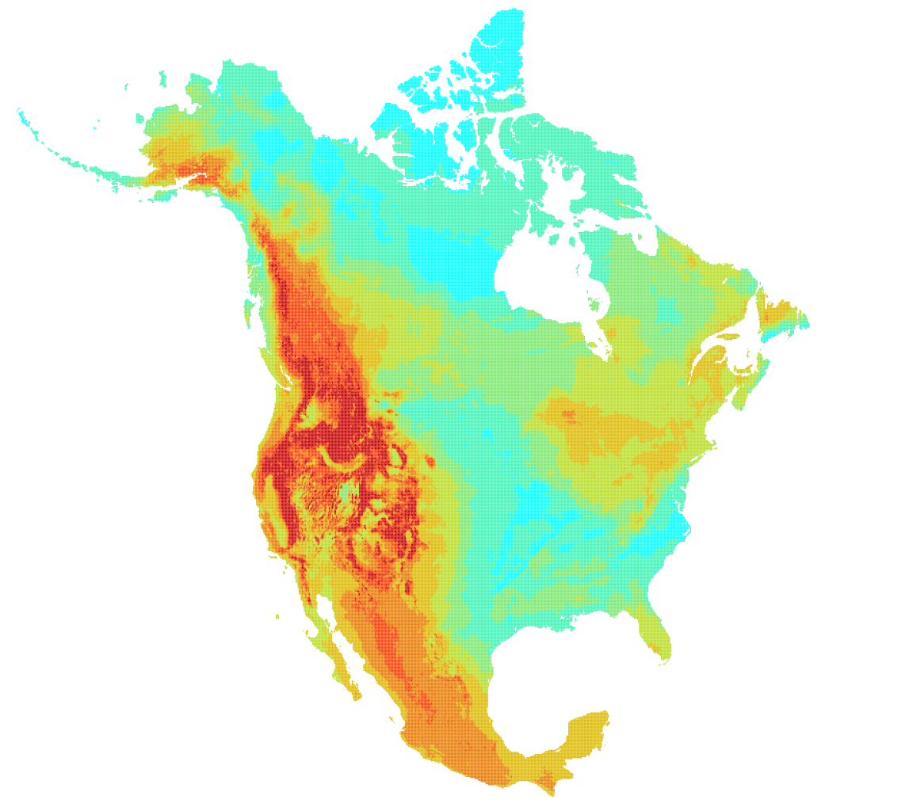


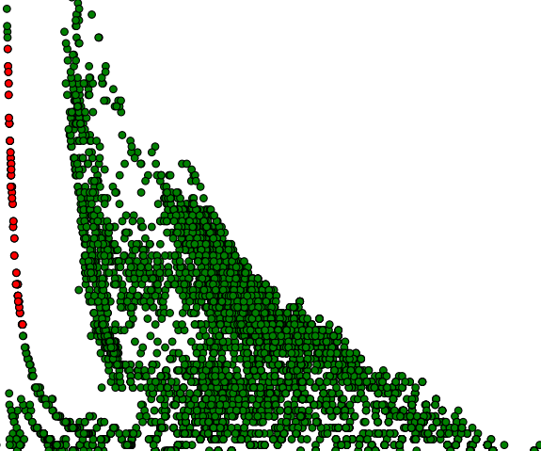

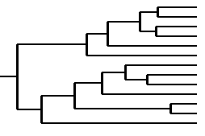
Lifemapper
ecological niche modeling
multi-species range and diversity analysis
visualization
3
Visualize linked maps, trees and plots
species data
1
Select clade
trees
2
analyze multi-species data:
measure macro-ecological shifts over time
quantify and qualify biodiversity
Notes:
Phil is right that Lifemapper has been around for over 10 years, but it started out as a much different product, has had several major incarnations and even went into hibernation for several years. Currently
Science infrastructure designed to be modular and extendable (so we can extend instead of re-architect)
It uses online species occurrence (map points) - museum specimen and inventory data
to predict where species should live based on where they have been found. .
predicts the spatial extents of species ranges for both current and future climates, and
enables analyses of regional and continental-scale patterns of species diversity
All with open source spatial data software tools and web services
In this PRAGMA exp. we use data aggregated by the iDigBio project as species input data –
We’re also extending to use phylogenetic or other types of trees, for example from the OpenTree project,

Slide 4
Lifemapper on PRAGMA Testbed
Notes:
As I mentioned, the Infrastructure is 2 parts,
LmCompute - computations
LmServer – data management and communications
An important part of the LM infrastructure is one user interface - Lifemapper plugin to the QGIS open source GIS application.
QGIS is a full-featured Geographic Information System,
allowing exploration and geospatial analysis of geospatial data.
Our QGIS plugin connects with the LM infrastructure and
allows users to request data and analyses, using LM data or user data

Slide 5
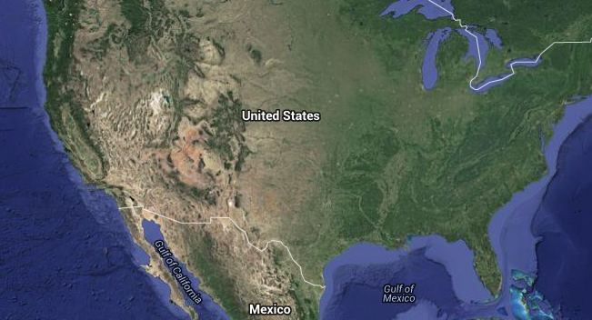

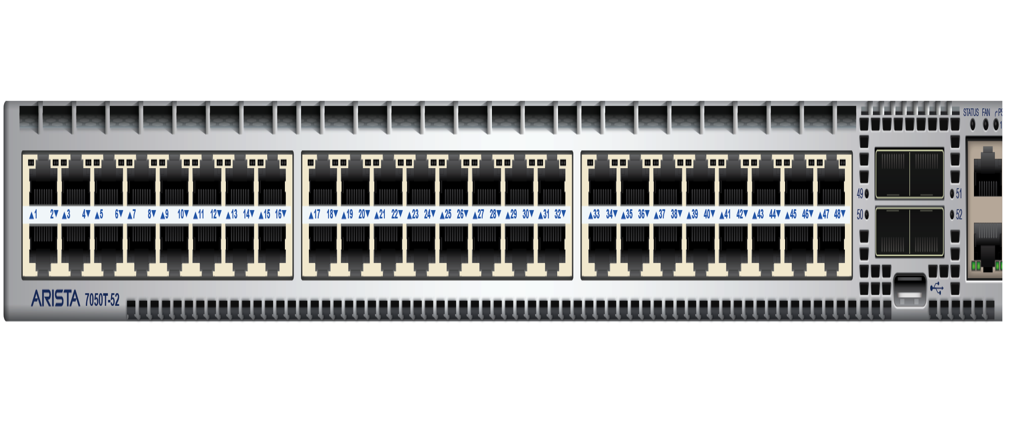




The infrastructure needed to make it work
LC
LS
LC
Cloud scheduler
Vine network
San Diego, CA
DATA
Gainesville, FL

Slide 6


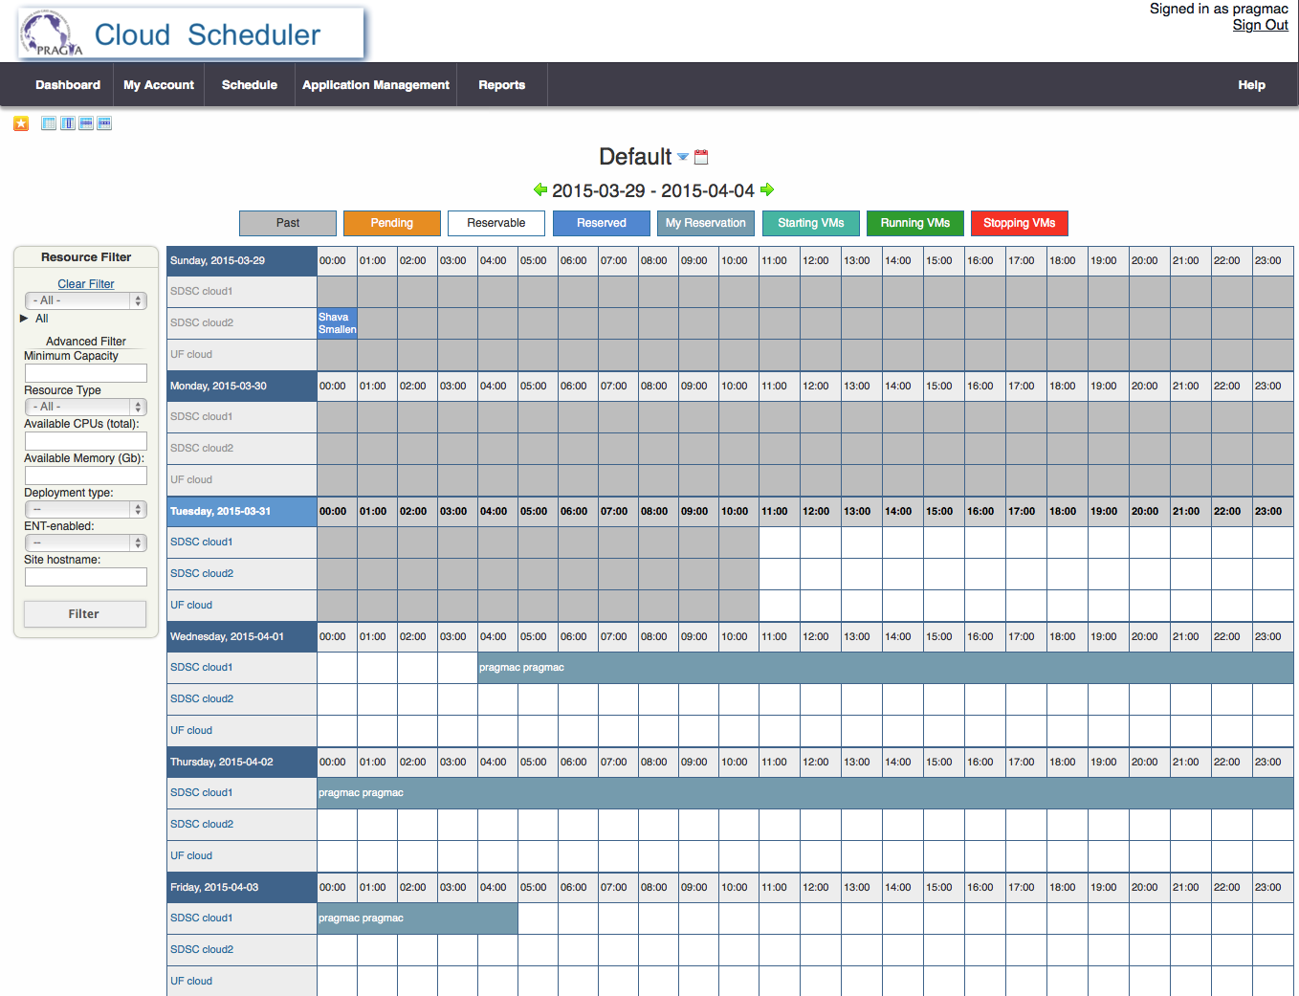
Integral components
SDSC
SDSC
UF
LC
DATA
LS
LC
VM Software
Rocks 6.2
lifemapper-compute
lifemapper-server
ipop
dynip
vine (package)
site
Central site
site
PRAGMA package
ssh
pragma_boot
pragma_agent
PRAGMA
booking
PCC
(per user)
http://calit2-119-121.ucsd.edu/cloud-scheduler
Notes:
Red color – not tested yet

Slide 7
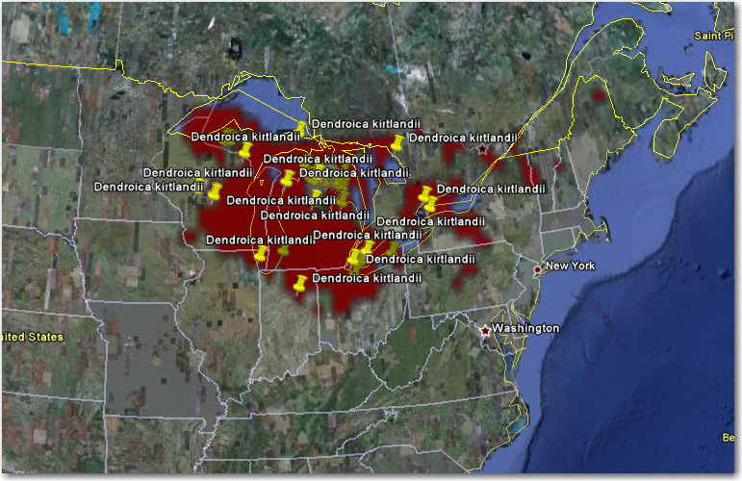
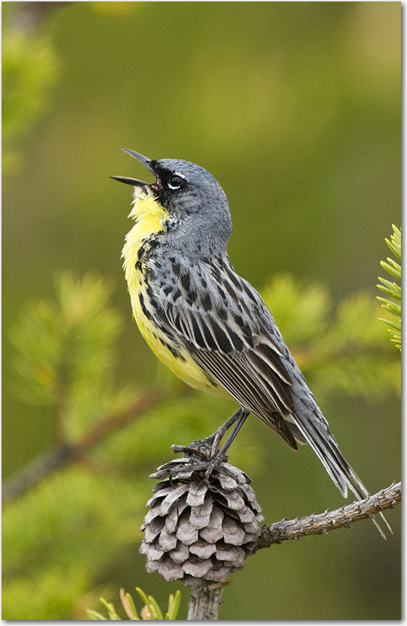
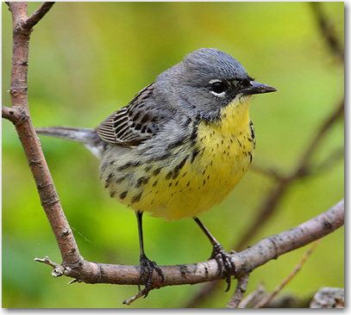
Kirtland’s Warbler Range
Notes:
Here is an example of the predicted distribution of the Kirtland’s Warbler – this is the predicted range given today’s climate

Slide 8
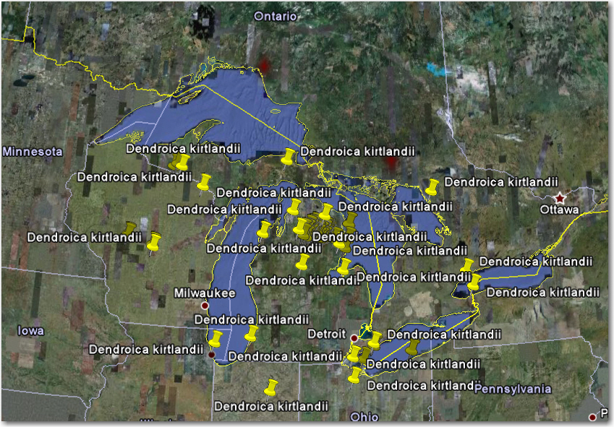
Kirtland’s Warbler Future
Kirtland’s Warbler Future
Notes:
And here is the predicted distribution after the climate change that might occur by the end of the century

Slide 9
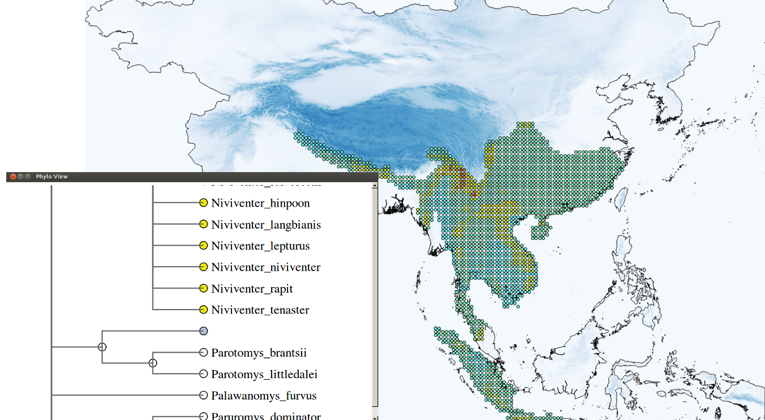

Lifemapper Integrates Phylogenetic Trees
Notes:
This is an example of the visual interface for a user, connecting to LM server through the QGIS plugin to request these analyses and data outputs.
This screen shows integration of phlogenetic trees in a multi-species analyses.
The analyses are done by the LM infrastructure, then returned to the user.

Slide 10
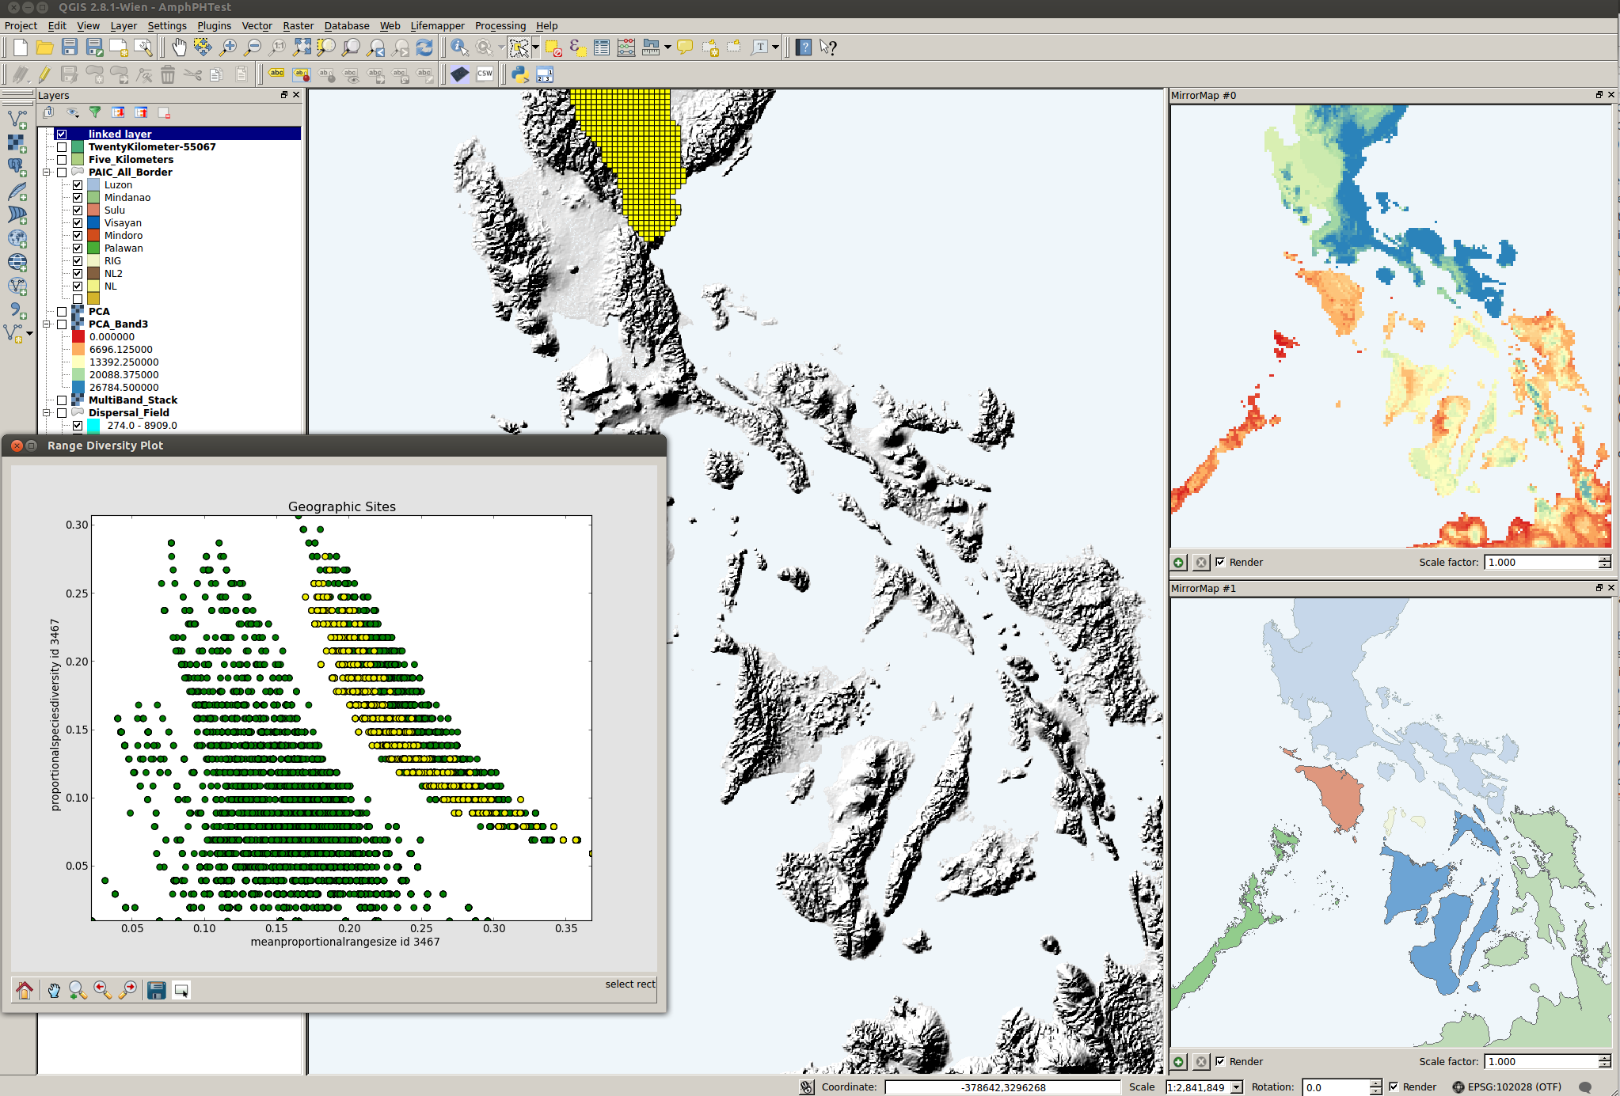
The PAICs of the Philippines
Notes:
Here is another example of the QGIS interface
looking at data calculated by Lifemapper for amphibians in the Phillipines.
On the right, the different colored Pleistocene aggregate island complexes (PAICs) on the right of the screen show similar species characteristics that evolved in islands that were previously connected by land bridges
In the plot on the lower left, you can see highlighted areas that are also highlighted in the in the northern island complex

Slide 11
Challenges
Identify memory leaks
Improve clunky data population process
Improve process to deal with complexity of software stack
Strengthen overlay network for accessing specialized data
Timeouts of mounted filesystem
Try iPOP and ViNe
Notes:
Problems encountered
memory usage discovered a memory leak – with few LM processes running – must identify culprit with testing and solve with configuration
Identify optimal memory to allow working with different datasets
Clunky process: Optimize data initialization and setup process to make easy for user - properly populate metadata prior to installation and location of data during installation

Slide 12
Next steps
To accommodate new scenarios and datasets
Further Lifemapper code modularization for custom data
Formalize requirements for fully described data (researcher, iDigBio, etc)
Modify process to configure on reservation with PRAGMA scheduler
For Mt. Kinabalu species and satellite data
Enable multi-species pattern analyses
Set up pipeline between Indonesia and other sites (ex: UFL with restricted satellite data)
Laptop installation of both components in single VC using mounted data
Notes:
Next steps
Use real Mt Kinabalu species data –
Deploy in other countries/institutions – start with UTM
for easy research use: Standardize format for species input dataUse real satellite data at UFL
LM will extend to use satellite data
LM will improve process for user-definition of these input data on both LmCompute and LmServer
Enable multi-species analyses of regional and continental-scale patterns of species diversity, very important for Mt Kinabalu one of the six most biodiverse locations on earth
Add mapping interface to deployable instances

Slide 13


Acknowledgements
This work is funded in part by National Science Foundation and USGS grants
PRAGMA
US NSF 1234953
Lifemapper
USGS BISON G14AC00285
US NSF BIO/ABI 0851290
Rocks
US NSF OCI-1032778
US NSF OCI-0721623
iDigBio
US NSF EF-1115210

